Slide 1

Lecture 13 The FastSLAM Algorithm
(continued)
Department of Mechanical Engineering and Automation
Haoyao Chen

Slide 2
Basic Algorithm
Do the following N times:
Retrieval. Retrieve a pose from the particle set .
Prediction. Sample a new pose .
Measurement update. For each observed feature identify the correspondence j for the measurement , and incorporate the measurement into the corresponding EKF, by updating the mean and covariance .
Importance weight. Calculate the importance weight for the new particle
Resampling.
Sample, with replacement, N particles, where each particle is sampled with a probability proportional to

Slide 3
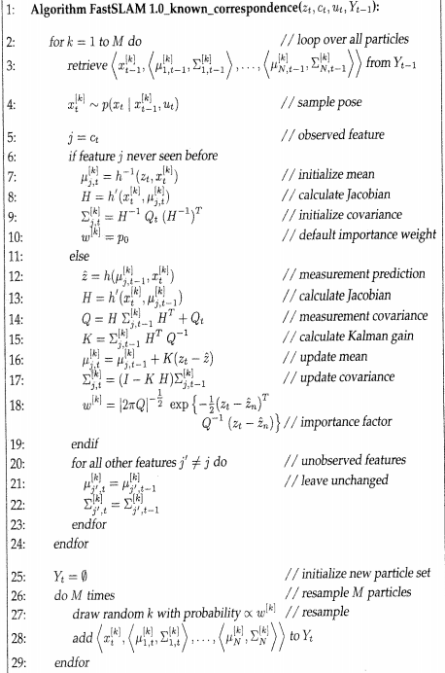
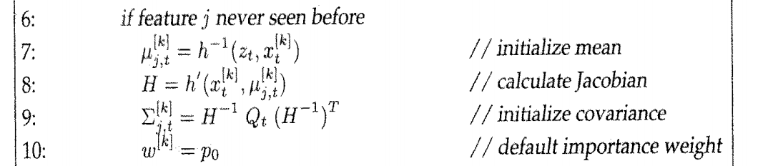
Retrieval
Prediction/Sampling
Measurement update:
New observed landmarks
Importance weight
Visited observed landmarks
Unobserved landmarks
Resampling

Slide 4
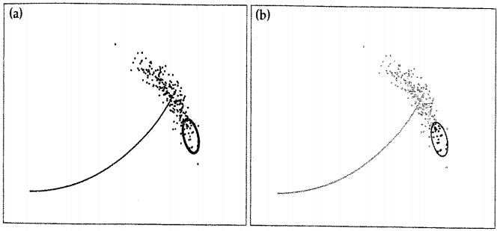
FastSLAM 2.0
Proposal distribution :
FastSLAM 1.0

Slide 5
Sampling

Slide 6
Convolution theorem( Chapter 3 for KF)
where
where
First, Second order derivative

Slide 7
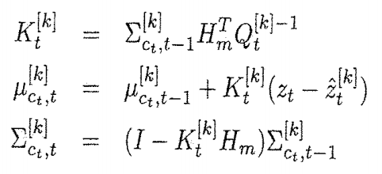
Update Feature Estimate
First, Second order derivative

Slide 8
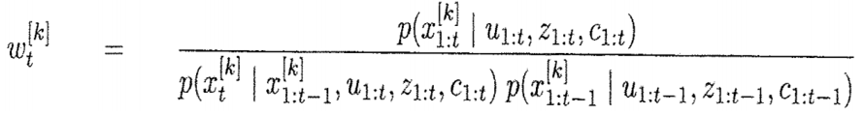
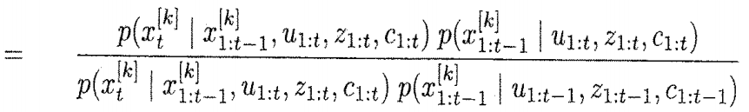
Calculate Importance Factors

Slide 10
where

Slide 11
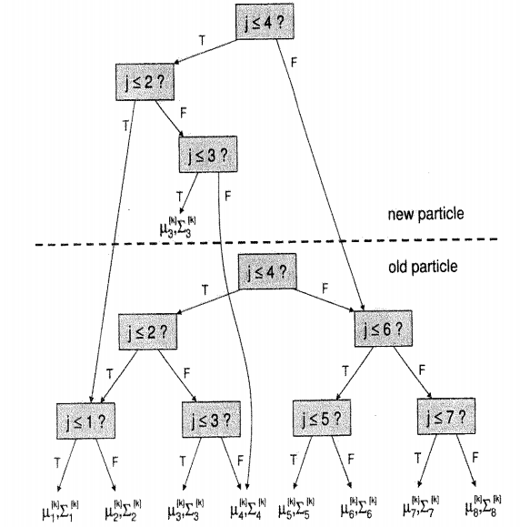
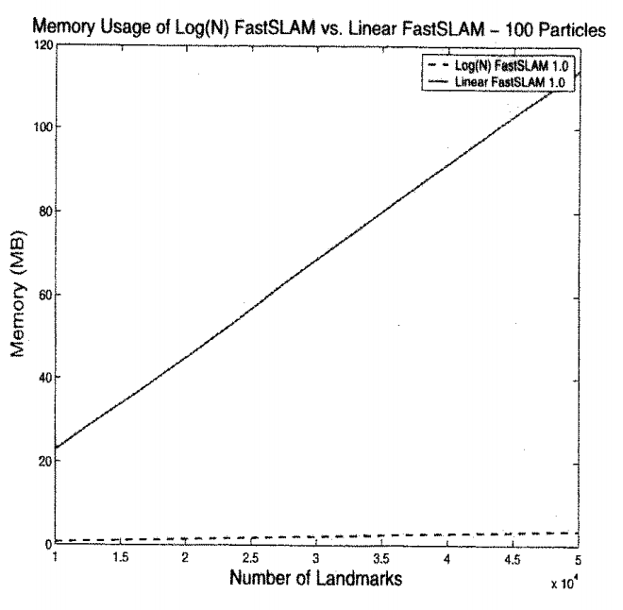
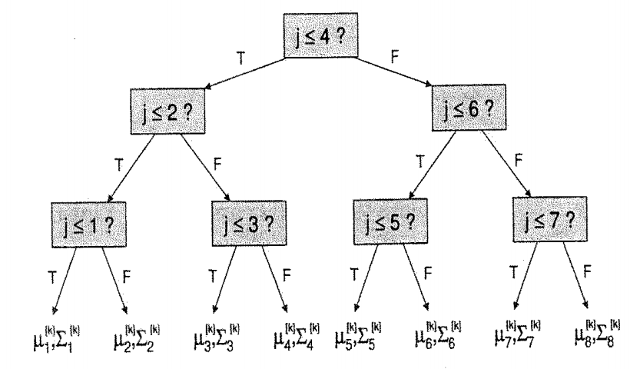
Efficient FastSLAM

Slide 12
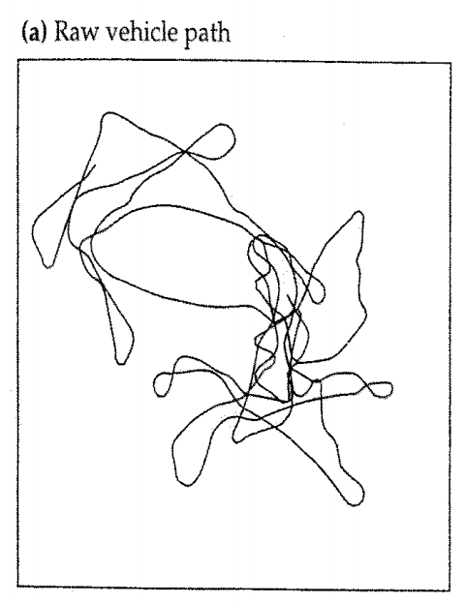
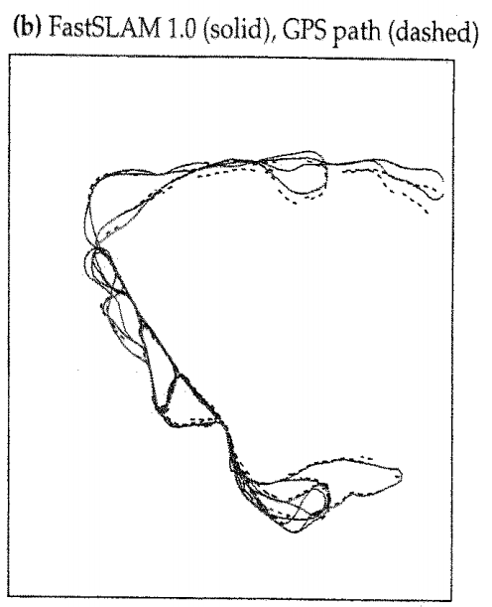
FastSLAM for Feature based Maps

Slide 13
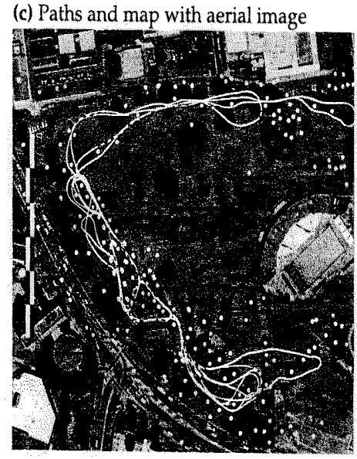
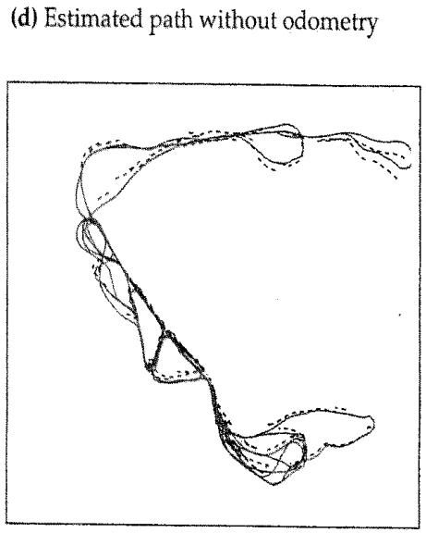

Slide 14
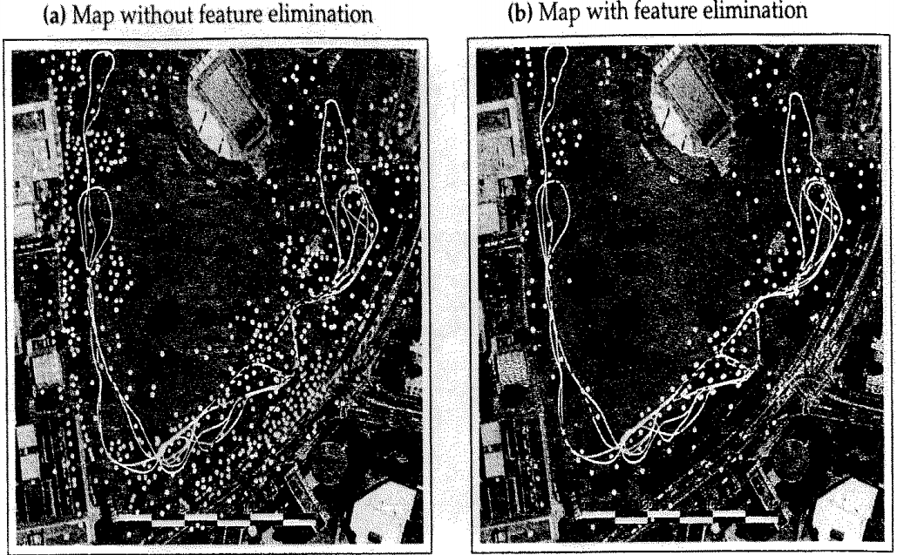

Slide 15
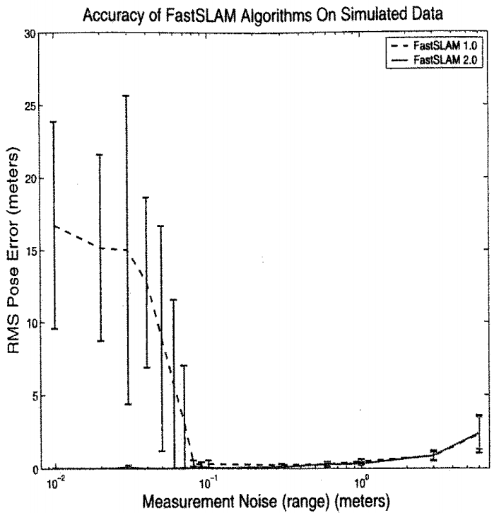

Slide 16
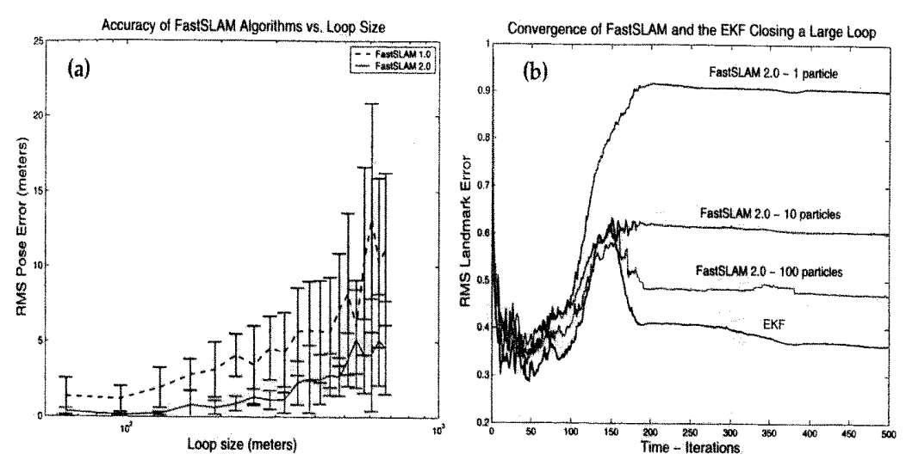

Slide 17
Grid-based SLAM
Can we solve the SLAM problem if no pre-defined landmarks are available?
Can we use the ideas of FastSLAM to build grid maps?
As with landmarks, the map depends on the poses of the robot during data acquisition
If the poses are known, grid-based mapping is easy (“mapping with known poses”)

Slide 18
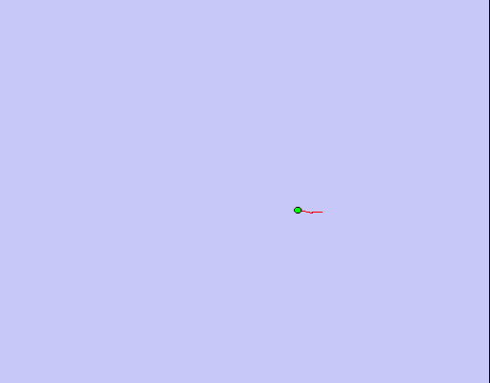
Mapping using Raw Odometry

Slide 19
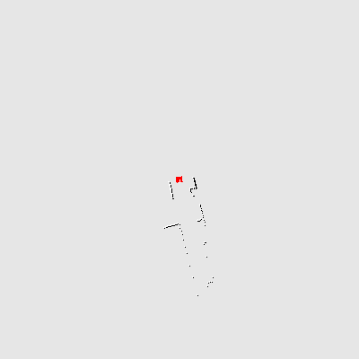
Mapping with Known Poses
Mapping with known poses using laser range data

Slide 20
Rao-Blackwellization
poses
map
observations & movements
Factorization first introduced by Murphy in 1999

Slide 21
Rao-Blackwellization
poses
map
observations & movements
SLAM posterior
Robot path posterior
Mapping with known poses
Factorization first introduced by Murphy in 1999

Slide 22
Rao-Blackwellization
This is localization, use MCL
Use the pose estimate from the MCL part and apply mapping with known poses

Slide 23
Rao-Blackwellized Mapping
Each particle represents a possible trajectory of the robot
Each particle
maintains its own map and
updates it upon “mapping with known poses”
Each particle survives with a probability proportional to the likelihood of the observations relative to its own map

Slide 24
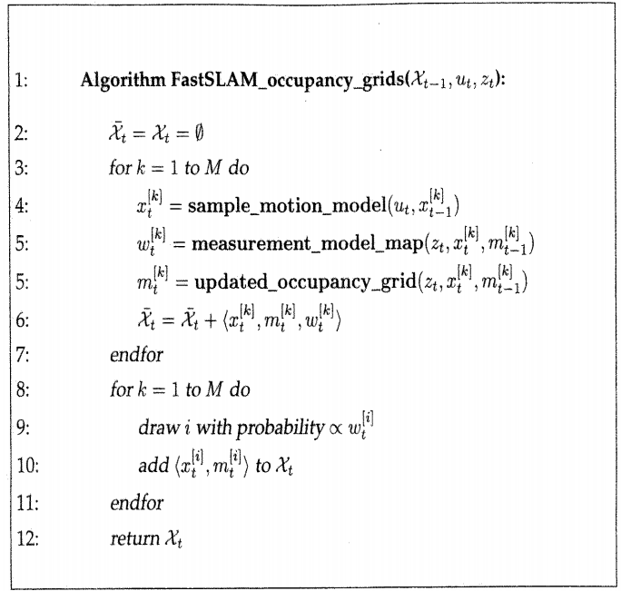
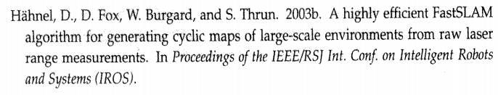

Slide 25
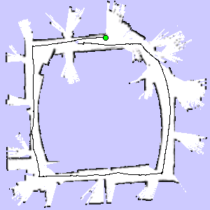
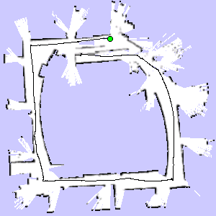

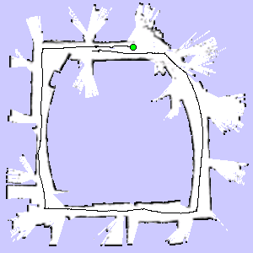
Particle Filter Example
3 particles
map of particle 1
map of particle 3
map of particle 2

Slide 26
Problem
Each map is quite big in case of grid maps
Since each particle maintains its own map
Therefore, one needs to keep the number of particles small
Solution: Compute better proposal distributions!
Idea: Improve the pose estimate before applying the particle filter

Slide 27
Pose Correction Using Scan Matching
Maximize the likelihood of the i-th pose and map relative to the (i-1)-th pose and map
current measurement
robot motion
map constructed so far
Notes:
To compute consistent maps, we apply a recursive scheme.
At each point in time we compute the most likely position of the robot, given the map constructed so far.
Based on the position hat l-t, we then extend the map an incorporate the scan obtained at time t.

Slide 28
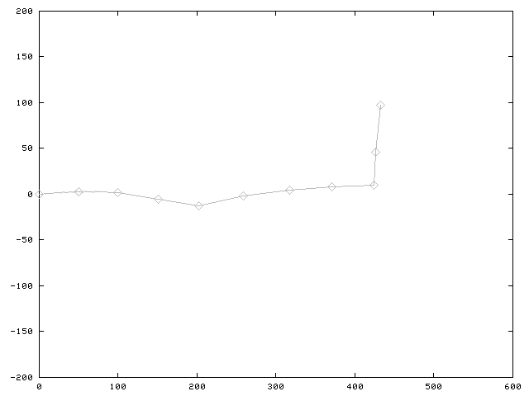
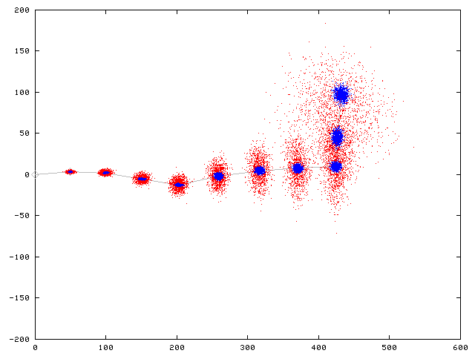
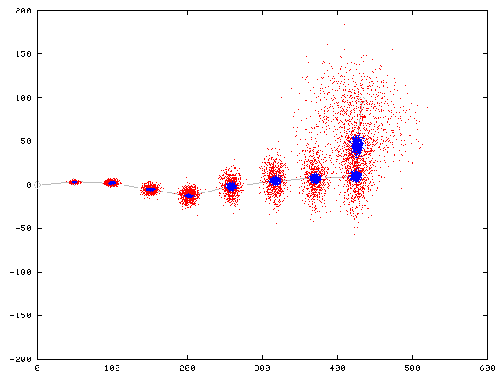
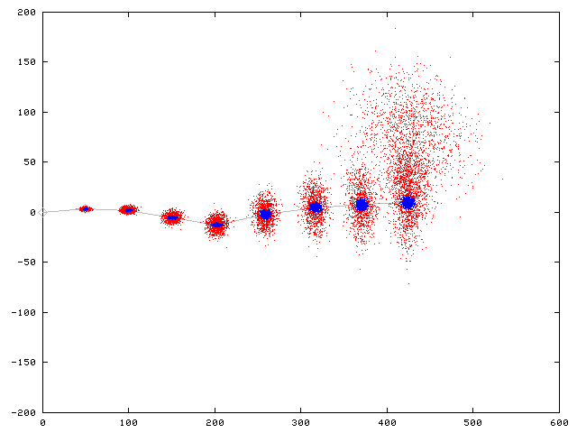
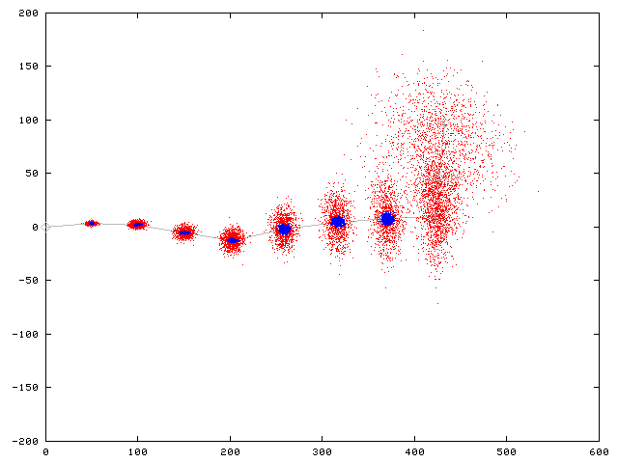







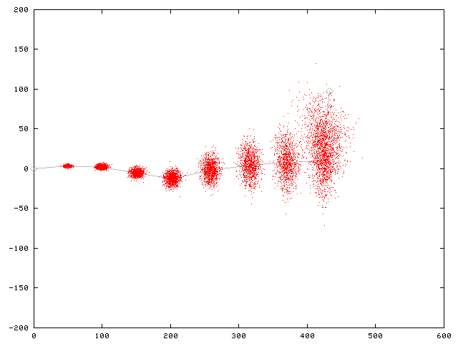
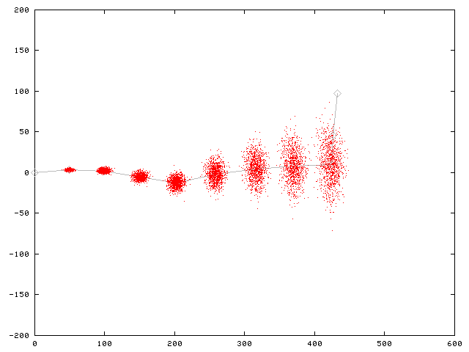
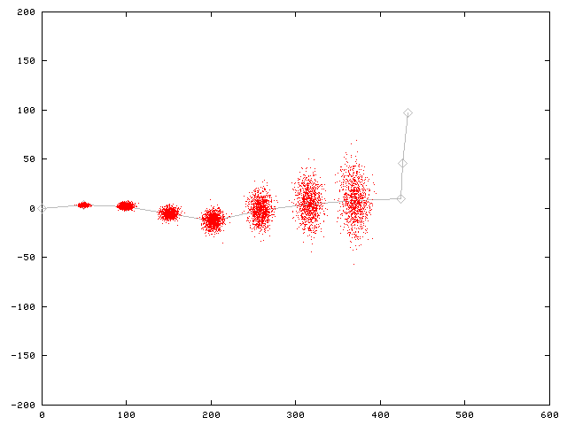
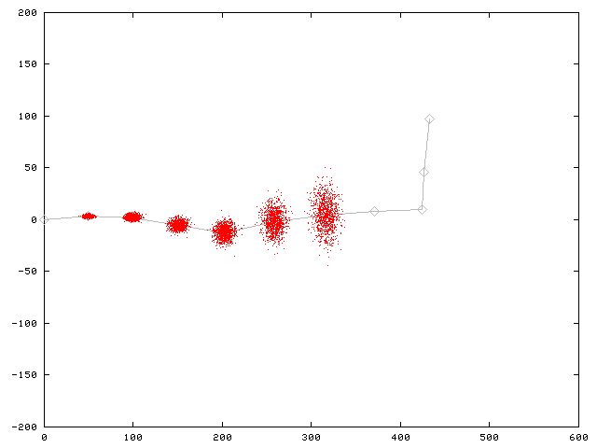
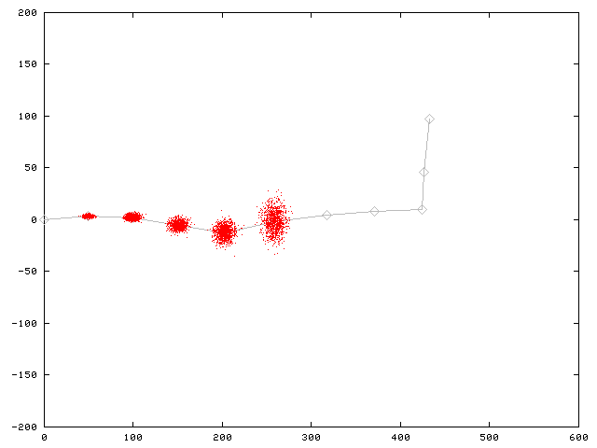
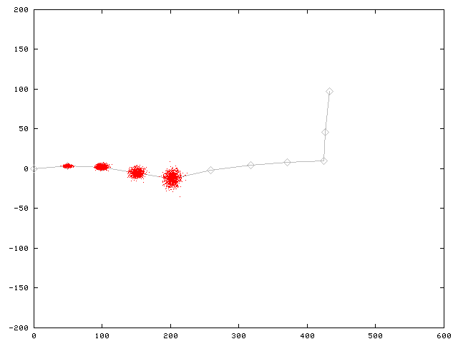
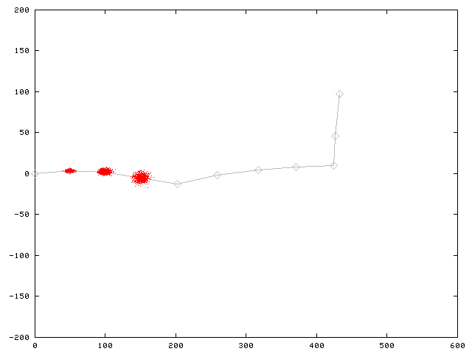
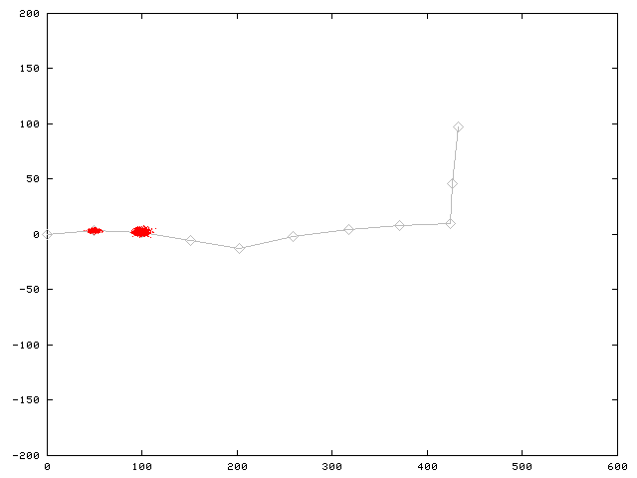
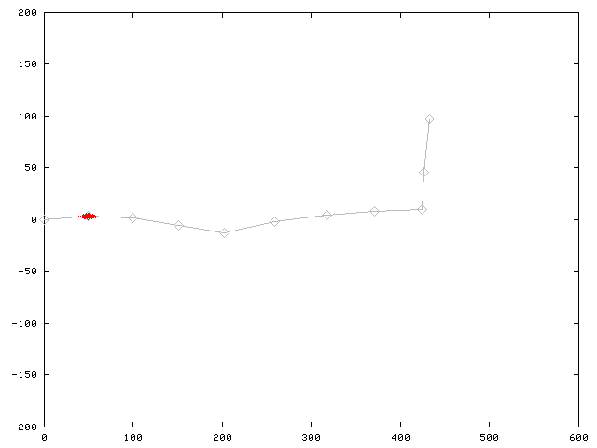
Motion Model for Scan Matching
Raw Odometry
Scan Matching

Slide 29
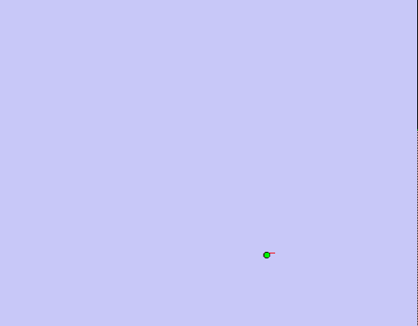
Mapping using Scan Matching

Slide 30
FastSLAM with Improved Odometry
Scan-matching provides a locally consistent pose correction
Pre-correct short odometry sequences using scan-matching and use them as input to FastSLAM
Fewer particles are needed, since the error in the input in smaller
[Haehnel et al., 2003]

Slide 31
Graphical Model for Mapping with Improved Odometry
u
...
u
u
...
u
u
...
u
0
z
k-1
k
z
2k-1
...
n·k
(n+1)·k-1
z
...
z
...
z
...
z
1
k-1
k+1
2k-1
n·k+1
(n+1)·k-1
u'
u'
...
u'
1
2
n
x
x
x
...
x
0
k
2k
n·k
m
z
z
...
z
k
2k
n·k

Slide 32
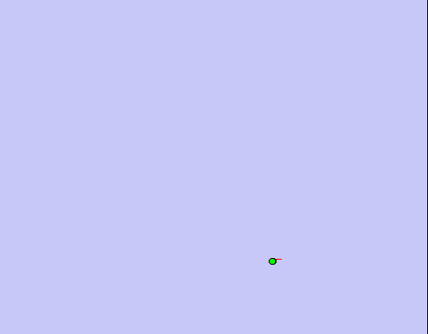
FastSLAM with Scan-Matching
Map: Intel Research Lab Seattle

Slide 33
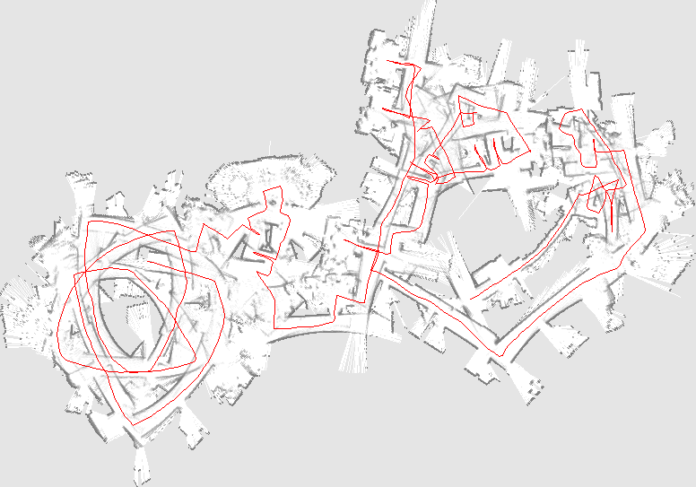
Comparison to Standard FastSLAM
Same model for observations
Odometry instead of scan matching as input
Number of particles varying from 500 to 100
Typical result:

Slide 34
Further Improvements
Improved proposals will lead to more accurate maps
They can be achieved by adapting the proposal distribution according to the most recent observations
Flexible re-sampling steps can further improve the accuracy.

Slide 35
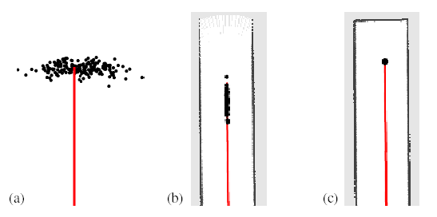
Improved Proposal
The proposal adapts to the structure of the environment

Slide 36
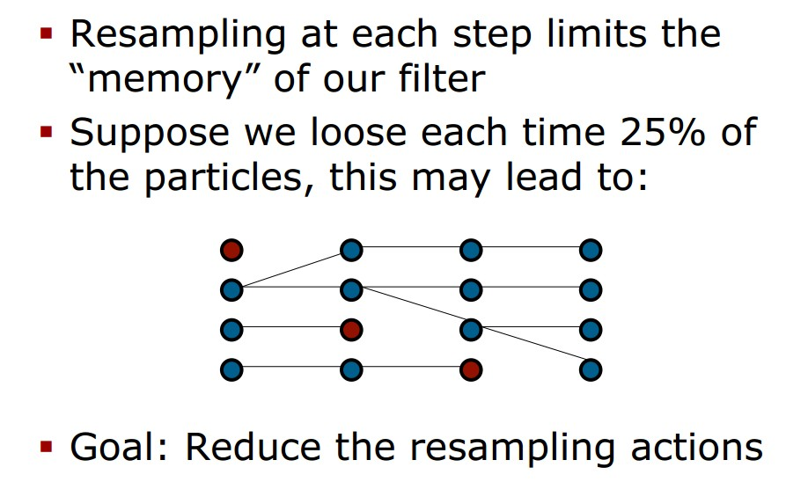
Selective Re-sampling
Re-sampling is dangerous, since important samples might get lost (particle depletion problem)
In case of suboptimal proposal distributions re-sampling is necessary to achieve convergence.
Key question: When should we re-sample?

Slide 37
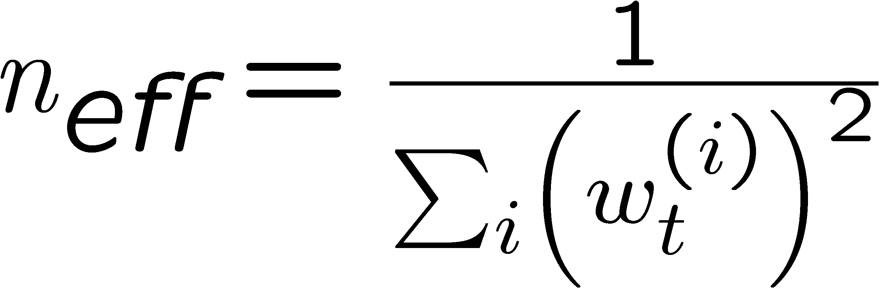
Number of Effective Particles
Empirical measure of how well the goal distribution is approximated by samples drawn from the proposal
n_{eff} describes “the variance of the particle weights”
n_{eff} is maximal for equal weights. In this case, the distribution is close to the proposal

Slide 38
Resampling with Neff
Only re-sample when n_{eff} drops below a given threshold (n/2)
See [Doucet, ’98; Arulampalam, ’01]

Slide 39
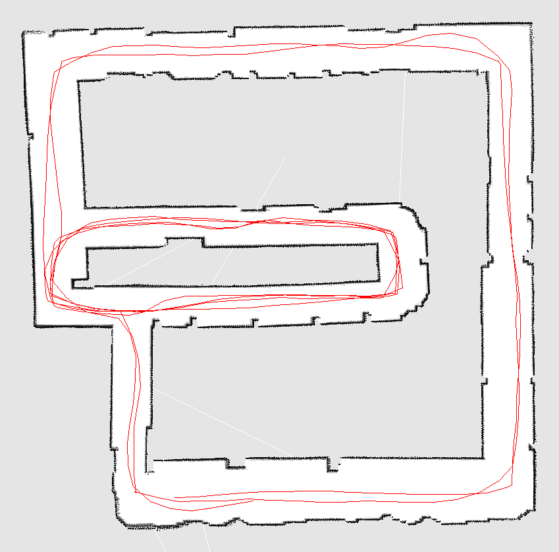
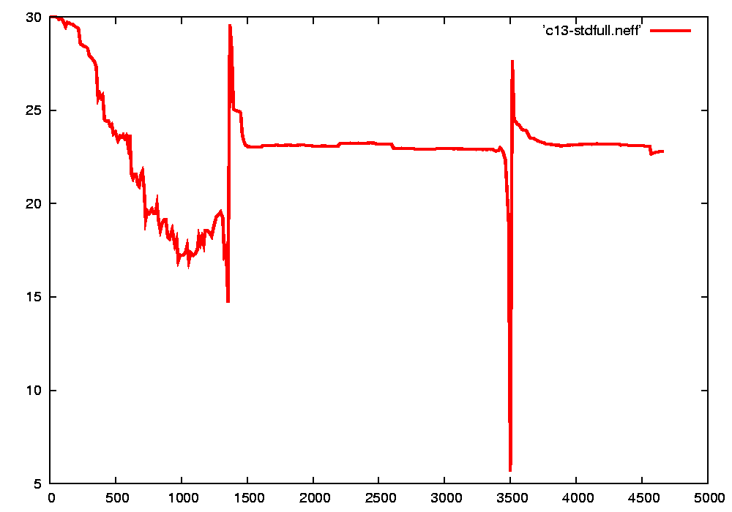
Typical Evolution of n_{eff}
visiting new areas
closing the first loop
visiting known areas
second loop closure

Slide 40
Literature Grid-FastSLAM with Improved Proposals
§ Grisetti, Stachniss, Burgard: Improved Techniques for Grid Mapping with RaoBlackwellized Particle Filters, 2007 § Stachniss, Grisetti, Burgard, Roy. Analyzing Gaussian Proposal Distributions for Mapping with Rao-Blackwellized Particle Filters, 2007
GMapping
§ Efficient open source implementation of the presented method (2005-2008)
§ C++ Code available via
svn co https://svn.openslam.org/data/svn/gmapping

Slide 41
Conclusion
The ideas of FastSLAM can also be applied in the context of grid maps
Utilizing accurate sensor observation leads to good proposals and highly efficient filters
It is similar to scan-matching on a per-particle base
The number of necessary particles and re-sampling steps can seriously be reduced
Improved versions of grid-based FastSLAM can handle larger environments than naïve implementations in “real time” since they need one order of magnitude fewer samples

Slide 42
More Details on FastSLAM
M. Montemerlo, S. Thrun, D. Koller, and B. Wegbreit. FastSLAM: A factored solution to simultaneous localization and mapping, AAAI02
D. Haehnel, W. Burgard, D. Fox, and S. Thrun. An efficient FastSLAM algorithm for generating maps of large-scale cyclic environments from raw laser range measurements, IROS03
M. Montemerlo, S. Thrun, D. Koller, B. Wegbreit. FastSLAM 2.0: An Improved particle filtering algorithm for simultaneous localization and mapping that provably converges. IJCAI-2003
G. Grisetti, C. Stachniss, and W. Burgard. Improving grid-based slam with rao-blackwellized particle filters by adaptive proposals and selective resampling, ICRA05
A. Eliazar and R. Parr. DP-SLAM: Fast, robust simultanous localization and mapping without predetermined landmarks, IJCAI03

